Slide 1
Topic – Testing Smart contract
Notes:
“Operating Systems: Internal and Design Principles”, 8/e, Global Edition by William Stallings, Chapter 5 “Concurrency: Mutual Exclusion and Synchronization”.

Slide 2
To do testing
Use truffle test framework
Use javascript – in practice, the ‘filename’ for the test file by default is the name of the SC, but with the first letter in lower case, eg simpleSmartContract.js
Notes:
At first glance, it may seem that interleaving and overlapping represent fundamentally different modes of execution and present different problems. In fact, both techniques can be viewed as examples of concurrent processing, and both present the same problems. In the case of a uniprocessor, the problems stem from a basic characteristic of multiprogramming systems: The relative speed of execution of processes cannot be predicted. It depends on the activities of other processes, the way in which the OS handles interrupts, and the scheduling policies of the OS.

Slide 3
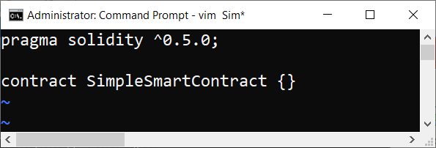
Simplest test mechanism
Using the simplest SC, ie empty SC
What can we test?
That the SC was successfully deployed
And if so, get the address of the SC, ie its address cannot be null.
Notes:
At first glance, it may seem that interleaving and overlapping represent fundamentally different modes of execution and present different problems. In fact, both techniques can be viewed as examples of concurrent processing, and both present the same problems. In the case of a uniprocessor, the problems stem from a basic characteristic of multiprogramming systems: The relative speed of execution of processes cannot be predicted. It depends on the activities of other processes, the way in which the OS handles interrupts, and the scheduling policies of the OS.

Slide 4
Using truffle
Assumed “truffle init” has been executed to create the current Project Framework.
Steps involved in testing:
Launch the local blockchain (ganache)
Execute command “truffle migrate”
Write the test javascript in a directory called “test”
Execute command “truffle test”
Notes:
At first glance, it may seem that interleaving and overlapping represent fundamentally different modes of execution and present different problems. In fact, both techniques can be viewed as examples of concurrent processing, and both present the same problems. In the case of a uniprocessor, the problems stem from a basic characteristic of multiprogramming systems: The relative speed of execution of processes cannot be predicted. It depends on the activities of other processes, the way in which the OS handles interrupts, and the scheduling policies of the OS.

Slide 5
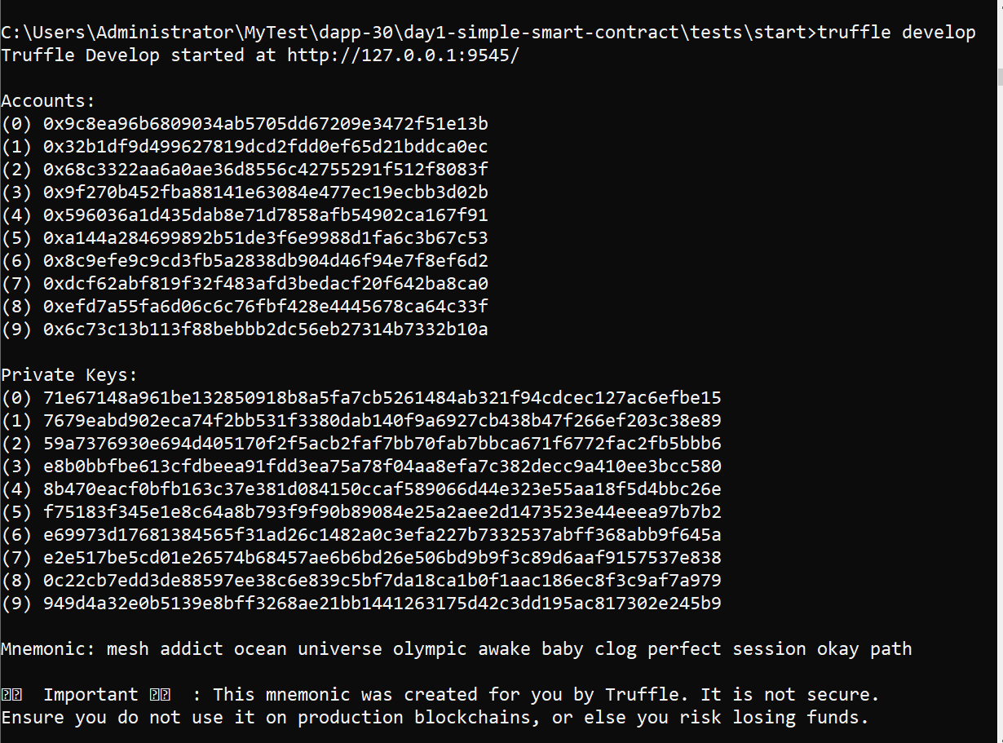
Launch the local blockchain
Notes:
At first glance, it may seem that interleaving and overlapping represent fundamentally different modes of execution and present different problems. In fact, both techniques can be viewed as examples of concurrent processing, and both present the same problems. In the case of a uniprocessor, the problems stem from a basic characteristic of multiprogramming systems: The relative speed of execution of processes cannot be predicted. It depends on the activities of other processes, the way in which the OS handles interrupts, and the scheduling policies of the OS.

Slide 6
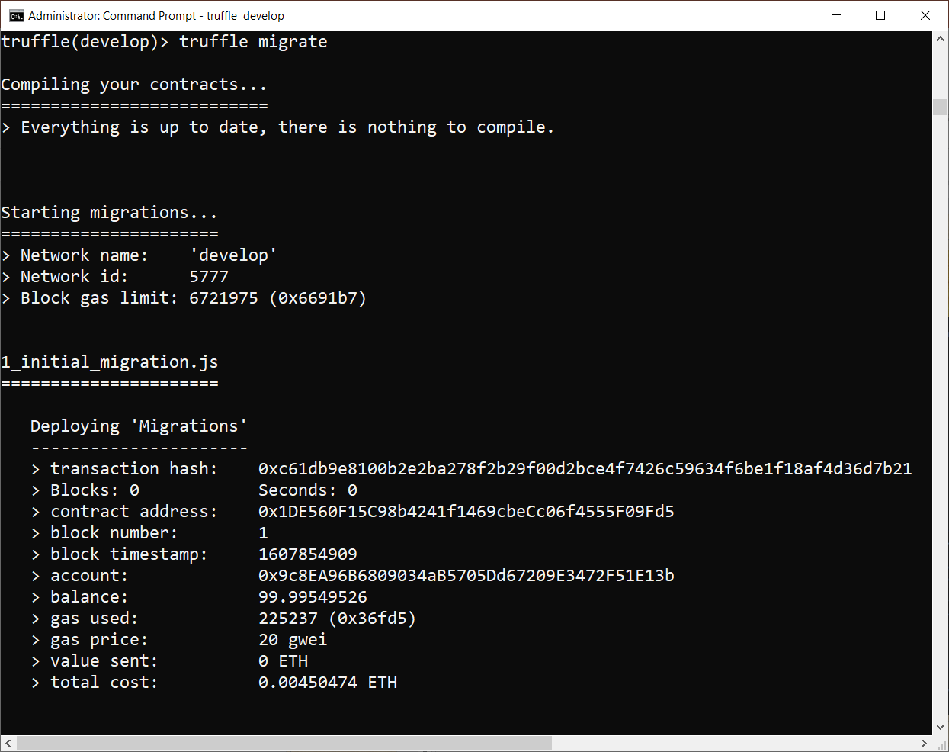
Execute truffle migrate/1
Notes:
At first glance, it may seem that interleaving and overlapping represent fundamentally different modes of execution and present different problems. In fact, both techniques can be viewed as examples of concurrent processing, and both present the same problems. In the case of a uniprocessor, the problems stem from a basic characteristic of multiprogramming systems: The relative speed of execution of processes cannot be predicted. It depends on the activities of other processes, the way in which the OS handles interrupts, and the scheduling policies of the OS.

Slide 7
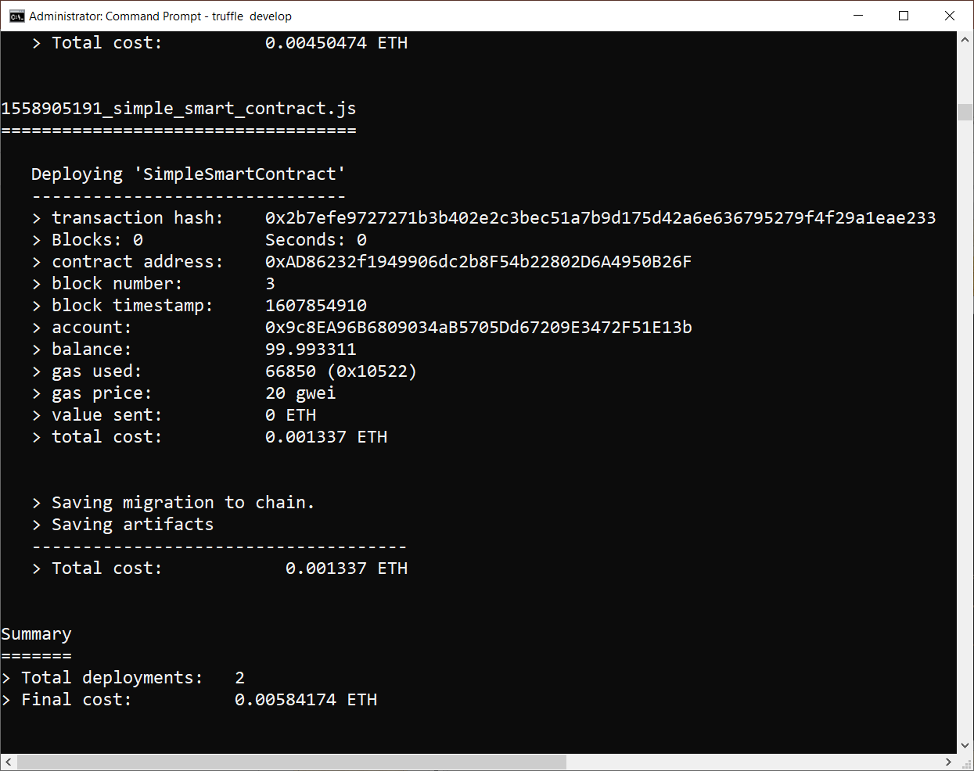
Execute truffle migrate/2
Notes:
At first glance, it may seem that interleaving and overlapping represent fundamentally different modes of execution and present different problems. In fact, both techniques can be viewed as examples of concurrent processing, and both present the same problems. In the case of a uniprocessor, the problems stem from a basic characteristic of multiprogramming systems: The relative speed of execution of processes cannot be predicted. It depends on the activities of other processes, the way in which the OS handles interrupts, and the scheduling policies of the OS.

Slide 8
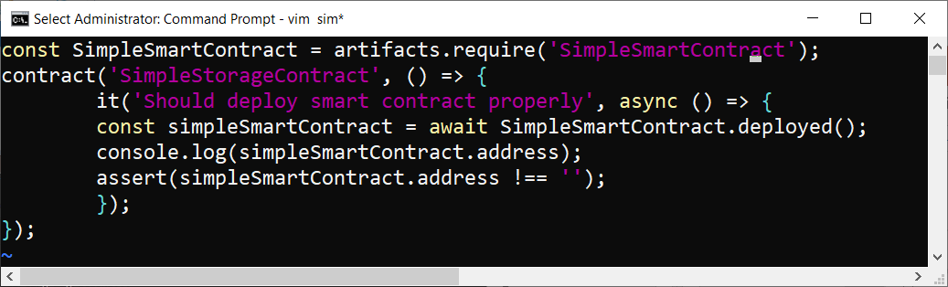
Write the test javascript
Call the filename – simpleSmartContract.js
Notes:
At first glance, it may seem that interleaving and overlapping represent fundamentally different modes of execution and present different problems. In fact, both techniques can be viewed as examples of concurrent processing, and both present the same problems. In the case of a uniprocessor, the problems stem from a basic characteristic of multiprogramming systems: The relative speed of execution of processes cannot be predicted. It depends on the activities of other processes, the way in which the OS handles interrupts, and the scheduling policies of the OS.

Slide 9
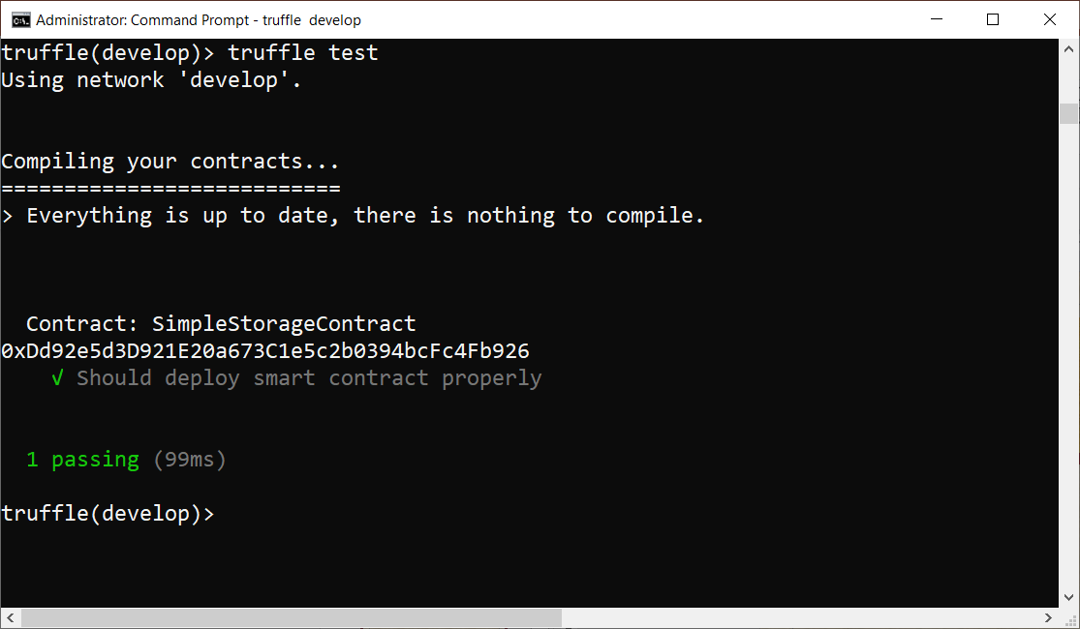
Execute truffle test
Notes:
At first glance, it may seem that interleaving and overlapping represent fundamentally different modes of execution and present different problems. In fact, both techniques can be viewed as examples of concurrent processing, and both present the same problems. In the case of a uniprocessor, the problems stem from a basic characteristic of multiprogramming systems: The relative speed of execution of processes cannot be predicted. It depends on the activities of other processes, the way in which the OS handles interrupts, and the scheduling policies of the OS.

Slide 10
Truffle test - successful
Notes:
At first glance, it may seem that interleaving and overlapping represent fundamentally different modes of execution and present different problems. In fact, both techniques can be viewed as examples of concurrent processing, and both present the same problems. In the case of a uniprocessor, the problems stem from a basic characteristic of multiprogramming systems: The relative speed of execution of processes cannot be predicted. It depends on the activities of other processes, the way in which the OS handles interrupts, and the scheduling policies of the OS.

Slide 11
Use of Java promise statement
Promise is a future like object that is used as a placeholder for a result of an asynchronous API.
Java Future is a synchronization construct that is used to block a thread that called get() method if result is not available yet.
Promise differs from it as it cannot be used for blocking.
Notes:
At first glance, it may seem that interleaving and overlapping represent fundamentally different modes of execution and present different problems. In fact, both techniques can be viewed as examples of concurrent processing, and both present the same problems. In the case of a uniprocessor, the problems stem from a basic characteristic of multiprogramming systems: The relative speed of execution of processes cannot be predicted. It depends on the activities of other processes, the way in which the OS handles interrupts, and the scheduling policies of the OS.

Slide 12
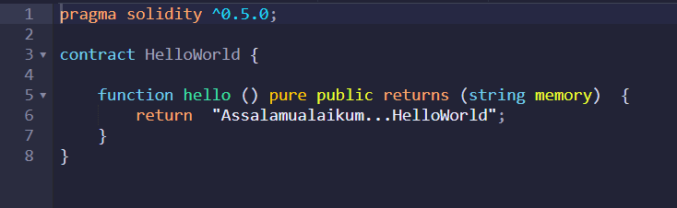
Simplest test mechanism
Add just one simple function into the SC
What can we test?
That the SC was successfully deployed
And if so, get the address of the SC, ie its address cannot be null.
Correct execution of the functtion
Notes:
At first glance, it may seem that interleaving and overlapping represent fundamentally different modes of execution and present different problems. In fact, both techniques can be viewed as examples of concurrent processing, and both present the same problems. In the case of a uniprocessor, the problems stem from a basic characteristic of multiprogramming systems: The relative speed of execution of processes cannot be predicted. It depends on the activities of other processes, the way in which the OS handles interrupts, and the scheduling policies of the OS.

Slide 13
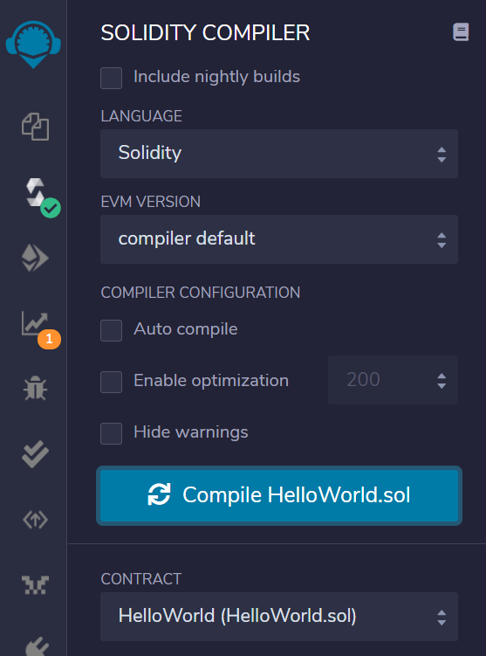
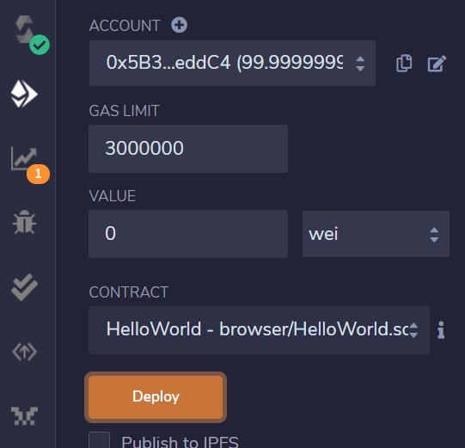
Compiled OK, then deploy
Notes:
At first glance, it may seem that interleaving and overlapping represent fundamentally different modes of execution and present different problems. In fact, both techniques can be viewed as examples of concurrent processing, and both present the same problems. In the case of a uniprocessor, the problems stem from a basic characteristic of multiprogramming systems: The relative speed of execution of processes cannot be predicted. It depends on the activities of other processes, the way in which the OS handles interrupts, and the scheduling policies of the OS.

Slide 14
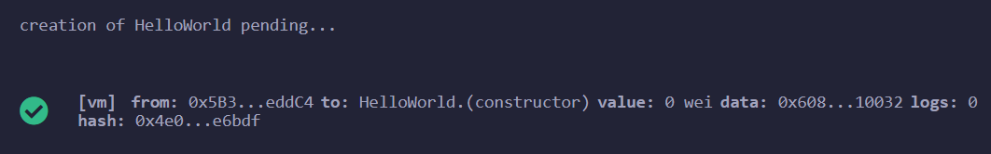
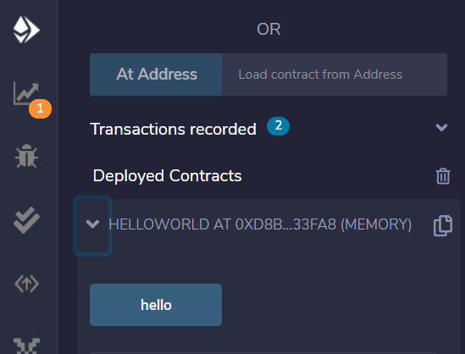
execute the function hello
Call the filename – simpleSmartContract.js
Notes:
At first glance, it may seem that interleaving and overlapping represent fundamentally different modes of execution and present different problems. In fact, both techniques can be viewed as examples of concurrent processing, and both present the same problems. In the case of a uniprocessor, the problems stem from a basic characteristic of multiprogramming systems: The relative speed of execution of processes cannot be predicted. It depends on the activities of other processes, the way in which the OS handles interrupts, and the scheduling policies of the OS.

Slide 15
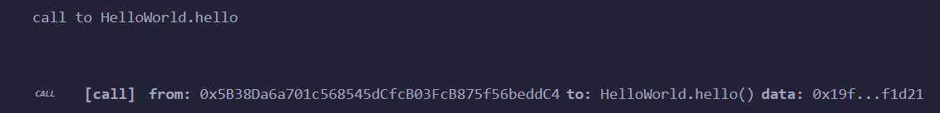
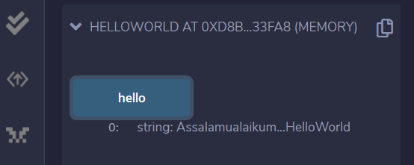
The function is OK
Shown in the console
String printed out
Notes:
At first glance, it may seem that interleaving and overlapping represent fundamentally different modes of execution and present different problems. In fact, both techniques can be viewed as examples of concurrent processing, and both present the same problems. In the case of a uniprocessor, the problems stem from a basic characteristic of multiprogramming systems: The relative speed of execution of processes cannot be predicted. It depends on the activities of other processes, the way in which the OS handles interrupts, and the scheduling policies of the OS.

Slide 16
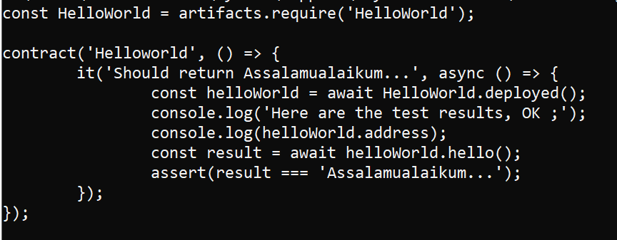
Write the test javascript
Call the filename – helloWorld.js
Notes:
At first glance, it may seem that interleaving and overlapping represent fundamentally different modes of execution and present different problems. In fact, both techniques can be viewed as examples of concurrent processing, and both present the same problems. In the case of a uniprocessor, the problems stem from a basic characteristic of multiprogramming systems: The relative speed of execution of processes cannot be predicted. It depends on the activities of other processes, the way in which the OS handles interrupts, and the scheduling policies of the OS.

Slide 17
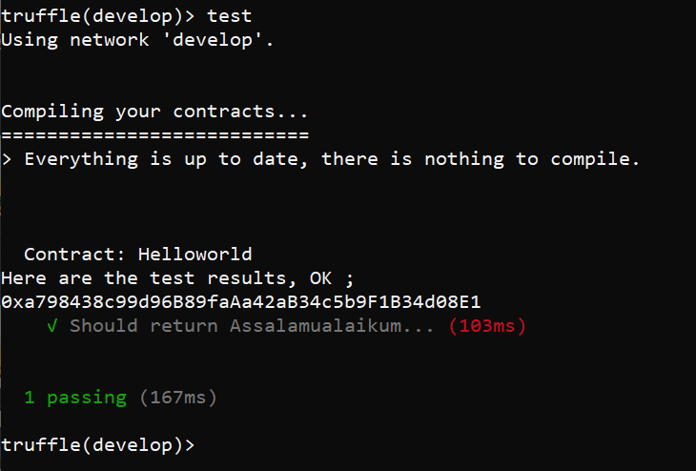
Execute & succeed
Notes:
At first glance, it may seem that interleaving and overlapping represent fundamentally different modes of execution and present different problems. In fact, both techniques can be viewed as examples of concurrent processing, and both present the same problems. In the case of a uniprocessor, the problems stem from a basic characteristic of multiprogramming systems: The relative speed of execution of processes cannot be predicted. It depends on the activities of other processes, the way in which the OS handles interrupts, and the scheduling policies of the OS.

Slide 18
End of this sub-topic
End of simple testing of smart contract
Notes:
At first glance, it may seem that interleaving and overlapping represent fundamentally different modes of execution and present different problems. In fact, both techniques can be viewed as examples of concurrent processing, and both present the same problems. In the case of a uniprocessor, the problems stem from a basic characteristic of multiprogramming systems: The relative speed of execution of processes cannot be predicted. It depends on the activities of other processes, the way in which the OS handles interrupts, and the scheduling policies of the OS.

